Slide 1
DNA fingerprinting
By: - Dr. Ravindra Pathre
HOD, Assistant Professor, Zoology
Mss College Ambad

Slide 2
DNA fingerprinting
DNA fingerprinting, also known as DNA profiling, genetic fingerprinting, or genotyping, is a laboratory technique used to determine the probable identity of a person based on the nucleotide sequences of certain regions of human DNA that are unique to individuals
In 1984, Alec Jeffreys developed the technique of DNA fingerprinting in his laboratory at the University of Leicester.
There are two main types of forensic DNA testing: one based on restriction fragment length polymorphism (RFLP) and the other on the polymerase chain reaction (PCR)

Slide 3
Steps of DNA fingerprinting
Sample Collection: First, a sample of cells (such as skin, hair, or blood cells) containing DNA is obtained.
DNA Extraction and Purification: The DNA is extracted from the cells and purified.
Polymerase chain reaction (PCR) is the next step in the process. In many situations, there is only a small amount of DNA available for DNA fingerprinting.
Fragmentation: In the original approach developed by British geneticist Alec Jeffreys, the DNA is cut at specific points using proteins called restriction enzymes. These enzymes produce fragments of varying lengths.

Slide 4
4. Electrophoresis: The sorted double-stranded DNA fragments are placed on a gel and subjected to an electric current. Shorter fragments move more quickly toward the positive pole (anode).
5. Blotting and Autoradiography: The fragments are transferred to a nylon sheet and exposed to radioactive DNA probes (synthetic DNA pieces). These probes bind to minisatellites, highly variable DNA sequences. An X-ray film is then exposed to the fragments, creating a unique pattern of dark marks where radioactive probes have attached.

Slide 5
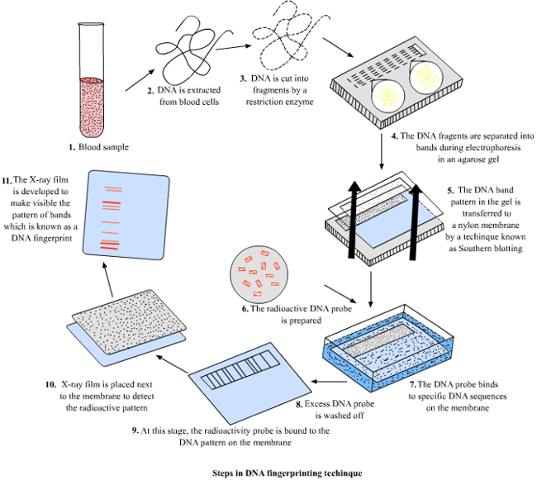

Slide 6
Application of DNA Fingerprinting
Forensic Science:
  DNA fingerprinting plays a crucial role in criminal investigations. By analyzing DNA samples from crime scenes and comparing them to suspects’ DNA, forensic experts can identify perpetrators or exonerate innocent individuals
  It helps match DNA evidence to criminal suspects, aiding in solving cases.
Paternity Testing:
  DNA fingerprinting is commonly used for paternity tests. By comparing the DNA profiles of a child, mother, and alleged father, it can determine biological parentage with high accuracy
  The technique relies on the fact that each individual has a distinct composition of variable number tandem repeats (VNTRs) in their DNA.

Slide 7
3. Personal Identification:
  In cases where identification is critical (e.g., disaster victims, missing persons), DNA fingerprinting helps establish identity by comparing DNA samples from the individual with reference samples from family members or stored databases.
  It’s also used for immigration purposes and to verify relationships.
4. Evolutionary Studies:
  Scientists use DNA fingerprinting to study evolutionary relationships among species. By analyzing similar DNA sequences, they can infer genetic relatedness and evolutionary history

Slide 8
References
https://th.bing.com/th/id/R.09b7b5ea651078ff5173ec5ea6668803?rik=zkJpmUhYp%2bfS7Q&riu=http%3a%2f%2fallaboutdnafingerprinting.weebly.com%2fuploads%2f2%2f4%2f5%2f3%2f24537576%2f6761344_orig.png&ehk=UcA3dS%2fjvCNelje10wv2%2f3T1hz%2ftAG4siaOBT%2b8hSe8%3d&risl=&pid=ImgRaw&r=0

Slide 9
Thank You

