Slide 1
Endocrine glands
Dr. Ravindra Pathre
HOD, Assistant Professor Zoology,
Mss College Ambad
.

Slide 2
Endocrine gland System
The endocrine system comprises glands, organs, and tissues that produce and regulate hormones. These hormones play a crucial role in coordinating various functions in your body. Here are some key points about the endocrine system

Slide 3
Function of the Endocrine System:
The primary function of the endocrine system is to release hormones into the bloodstream. These hormones act as messengers, coordinating different processes in the body.
Some key functions include:
Metabolism: Regulating energy production and utilization.
Homeostasis: Maintaining internal balance (e.g., blood pressure, blood sugar, fluid balance, and body temperature).
Growth and development
Sexual function
Reproduction
Sleep-wake cycle
Mood regulation

Slide 4
Endocrine Glands:
These glands are specialized tissues that produce and release hormones directly into the blood. They include:
Pineal gland: Located in the brain, it produces melatonin, which influences sleep patterns.
Pituitary gland: Situated at the base of the brain, it releases eight hormones that control other endocrine glands.
Thyroid gland: Found in the neck, it regulates metabolism.
Parathyroid glands: Four small glands behind the thyroid, involved in calcium balance.
And more, such as the pancreas, adrenal glands, and ovaries/ testicles

Slide 5
Hormone function
Regulate the environment's chemical composition and volume (extracellular fluid).
Help regulate metabolism and energy balance.
Hormones are chemical messengers produced by glands in our body.
The messenger travels through the bloodstream to target organs, directing how those organs function.
Help regulate contraction of smoot and cardiac muscle fibres and secretion by glands.

Slide 6
Exocrine and endocrine glands
Exocrine gland secrete their substances through ducts onto your body’s surface.
Examples of exocrine glands include :
Salivary glands: these produce saliva, aiding in digestion and mouth/ throat lubrication.
Sweat glands: Responsible for controlling body temperature.
Mammary glands: in the breasts, they produce milk for breastfeeding.

Slide 7
Endocrine glands :
Endocrine glands are ductless and release hormones directly into the bloodstream.
Example of endocrine glands :
Pituitary gland: located at the base of the brain, it produces hormones for growth and metabolism.
Thyroid gland: Produces thyroid hormones crucial for various bodily functions.
Adrenal glands: Situated above the kidneys, they regulate heart rate and blood pressure.
Pancreas: Creates hormones for digestion and blood sugar regulation
Ovaries (in Females) and testicles (in males) : Responsible for reproductive hormones.

Slide 8
The Endocrine gland system is composed of the body’s endocrine glands. These include :
The pituitary, thyroid, parathyroid, adrenal, pina glands, and pancreatic islets.
There are also many organs that have cells that secrete hormones but are not exclusively endocrine organs.
These include :
The hypothalamus, thymus, pancreas, ovaries, testes, kidneys, stomach, liver, small intestine, skin, heart, and placenta.

Slide 10
Hormones
Hormones are chemical substances that are carried by a cell tissue and initiate specific action.
Hormones can have very powerful effects, even when present in very low concentrations.
The specific cells which are affected by a hormone are called target cells.
Hormones influence their target cells by binding to proteins or glycoproteins in the cell membrane called receptors.

Slide 11
The pituitary gland and hypothalamus
The pituitary gland or hypophysis is attached to the hypothalamus at the base of the brain.
Although the pituitary gland is sometimes called the master endocrine gland.
together, the hypothalamus and pituitary gland regulate virtual
, all aspects of growth, development, metabolism, and homeostasis.
The pituitary gland can be divided into the posterior pituitary and anterior pituitary.

Slide 12
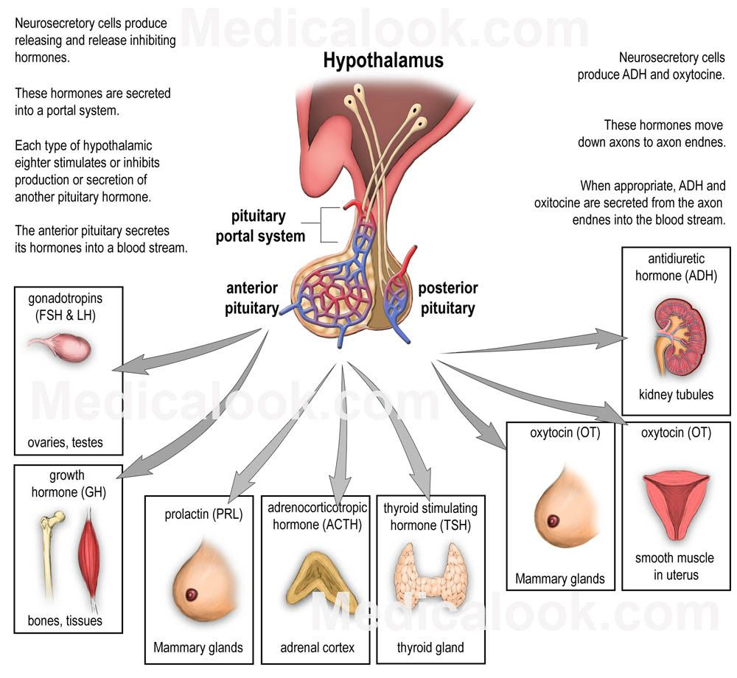

Slide 13
Hypothalamus:
Located in the brain, the hypothalamus serves as a crucial link between the endocrine system and the nervous system.
It produces and secretes various hormones.
The hypothalamus regulates the pituitary gland through inhibiting and releasing hormones.
These hormones stimulate or inhibit the production of hormones in the anterior pituitary.
Think of it as the “command center” for coordinating endocrine and nervous system messages

Slide 14
Pituitary Gland
the pituitary gland, also known as the hypophysis, is a bean-sized organ suspended from the hypothalamus by the infundibulum (pituitary stalk).
It consists of two lobes:
Anterior Pituitary (Adenohypophysis):
Glandular tissue derived from the primitive digestive tract.
Produces several hormones:
Growth hormone (GH): Promotes body tissue growth.
Prolactin (PRL): Stimulates milk production.
Thyroid-stimulating hormone (TSH): Regulates thyroid hormone release.
Adrenocorticotropic hormone (ACTH): Stimulates adrenal cortex hormone release.
Follicle-stimulating hormone (FSH) and Luteinizing hormone (LH): Involved in gamete production.

Slide 15
Posterior Pituitary (Neurohypophysis):
eural tissue.
Releases:
Oxytocin: Involved in labor induction and milk ejection.
Vasopressin (Antidiuretic hormone, ADH): Promotes water reabsorption by kidneys.

Slide 16
Thank you

