Slide 1
enzymes
By:- Dr. Ravindra Pathre
HOD, Assistant Professor Zoology,
Mss College Ambad

Slide 2
Enzymes
enzymes are biological catalysts that accelerate the rate of reaction without consuming themselves.
In living cells they are produced by the living organism in small amounts.
Functions: digestion, synthesis, and breakdown of Carbohydrates, proteins, and fats. Etc.
enzymes act on the substrate.
enzymes convert substrate into product.
Ex: Glucose6p [glucose + Phosphate glucose6p
hexokinase

Slide 3
physical properties:
1. Heat labile
2. Soluble in water
3. Precipitate by precipitating agent ( ammonium sulphate or trichloroacetic acid).
General properties of enzymes:
1. all enzymes are proteins.
2. enzymes accelerate the reaction but:
a. they do not alter the reaction equilibrium
b. they are not consumed in the overall reaction
c. They are required in very small quantities.
3. enzymes are highly specific for their substrate.
4. enzymes possess active site, at which interaction with substrate
takes place.
5. RNA molecules that act like enzymes called Ribozymes. it was
the first biocatalyst on earth.
6. Enzyme requires 3D confirmation for catalysis.

Slide 4
Nomenclature
Enzymes are usually named according to the reaction they carry out.
To generate the name of an enzyme, the suffix -ase is added to the name of its substrate ( e. g. , lactase is the enzyme suffix -ase is added to the name of its substrate ( e. g. , lactase is the enzyme that cleaves lactose) or the type of reaction (e.g., DNA polymerase synthesizes DNA polymers).
Systematic name (International classification )
By the reactions they catalyze (Six classes)

Slide 5
Classification of enzymes
Oxidoreductases :- this class transefer hydrogen /oxygen from one substrate to another eg. Dehydrogenases, reductases, catalase
Transferases :- this class transfer chemical groups between substrates , it includes kinases, aminotransferases
Hydrolases:- this class catalysis reaction using water, it mostly consist of digestive enzymes e.g. Protease, lipase
Lyase :- They can form or break chemical bond without using high energy e.g. Enolase, fumarase
Isomerase :- it requires single substrate to transfer functional group e.g. Isomerse, mutase
Ligase :- To form covalent bond it requires energy in the form of ATP/NAD e.g. DNA ligases

Slide 6
Mechanism of Action of Enzymes
Enzymes increase reaction rates by decreasing the Activation energy:
• Enzyme-Substrate Interactions:
‒Formation of Enzyme substrate complex by:
Lock-and-Key Model
Induced Fit Model

Slide 7
Lock-and-Key Model:
• In the lock-and-key model of enzyme action:
- the active site has a rigid shape
- only substrates with the matching shape can fit
- the substrate is a key that fits the lock of the active site
• This is an older model, however, and does not work for all enzymes

Slide 8
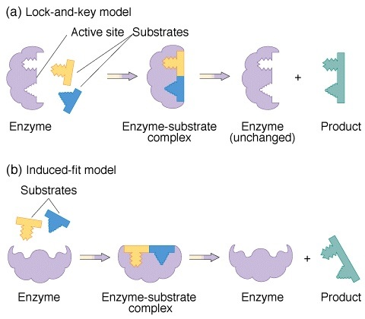

Slide 9
induced fit model:
In the induced-fit model of enzyme action:
the active site is flexible, not rigid
the shapes of the enzyme, active site, and substrate adjust to maximize the fit, which improves catalysis
there is a greater range of substrate specificity
This model is more consistent with a wider range of enzymes

Slide 10
Factors affecting enzyme activity:
1.Enzyme concentration.
a. The rate of reaction depends directly on the amount of enzyme present.
b. At a specific time.
c. Unlimited substrate concentration.
If the amount of enzyme is increased by two fold, the reaction rate is doubled.

Slide 11
2. Substrate concentration.
The rate of reaction is directly proportional to the substrate available.
b. If the enzyme concentration is kept constant, and the amount of substrate is Increased.
c. Further increase in the substrate, does not increase the rate of the reaction any more

Slide 12
3. Temperature
The rate of enzyme may increase with increase in temperature but up to a certain limitation
All enzymes can work at their maximum rate at optimum temperature.
For enzymes of human body 37°C is the optimum temperature.
Enzymes denature at high temperatures

Slide 13
4. Value of PH.
a. Enzymes have specific range of PH at which will work.
b. loose activity in low or high PH.
c. Enzyme denature (change shape and become ineffective). (in temperature and PH)

Slide 14
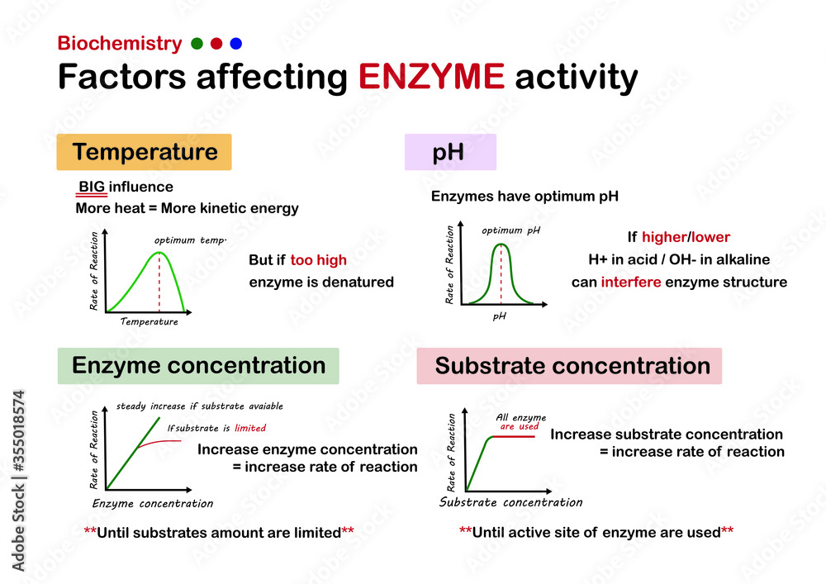

Slide 15
References
https://th.bing.com/th/id/R.879d18012c294796669fefdf059362dc?rik=PIeeK52YzRIk3g&riu=http%3a%2f%2fwww.assignmenthelp.net%2fimages%2fenzyme-substrate-co-operation.jpg&ehk=T6KUOGgv9BwFoRk8tY%2fSPqcNH8E4svyV6FDJD5HQ9II%3d&risl=&pid=ImgRaw&r=0
https://as2.ftcdn.net/v2/jpg/03/55/01/85/1000_F_355018574_uYepM3I4hfSOx1cx2uhhGm6KiotjJgo3.jpg

Slide 16
Thank You

