Slide 1
Fossils and Types Of Fossils
What are Fossils?
Mechanism of Fossil formation
Types of Fossils
By:-
Dr. Ravindra Pathre
HOD, Assistant Professor Zoology,
Mss College Ambad

Slide 2
What are Fossils?
The preserved remains of ancient organisms having an age of more than ten thousand years called as fossils
Fossils tells us the body form or morphology of organisms that lived long year ago, how and where they lived.
Fossils provide a direct record of evolution, they occurs in sedimentary rocks formed during earth history.
A study of fossils in sedimentary layers indicates the geological period in which they existed.
Paleontology is the study of past life based on the fossil record.
Georges Cuvier was father of Paleontology.

Slide 3
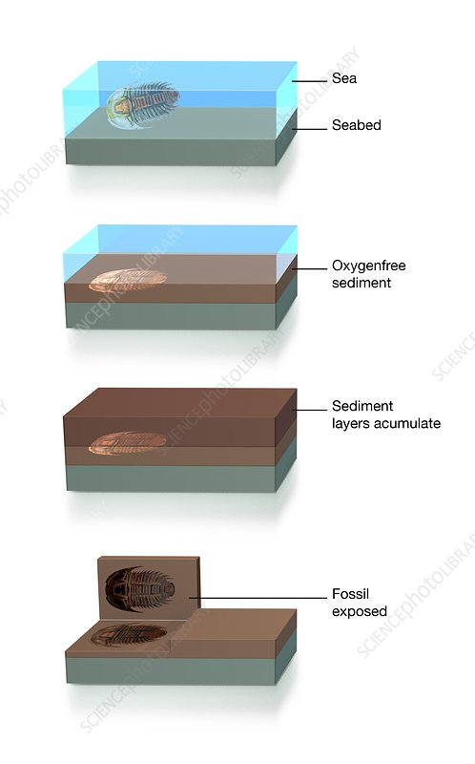
What is the Mechanism of Fossil formation ?
Dead animals of the sea/ rivers/ land/large lakes carried to the sink down and buried in the rocks.
Supply of oxygen is limited in this condition, so prevent decay or reduce the decay rate.
Animals remain preserved in the rock formed fossils.
The fossils are present in deeper layer are earlier and upper layer had more recent fossils.
Fossils are distributed in amber, asphalt, ice, storm dust and sand dunes.

Slide 4
Types of Fossils
True fossils
Petrified fossils
mold fossils
Cast fossils
Living fossils

Slide 5
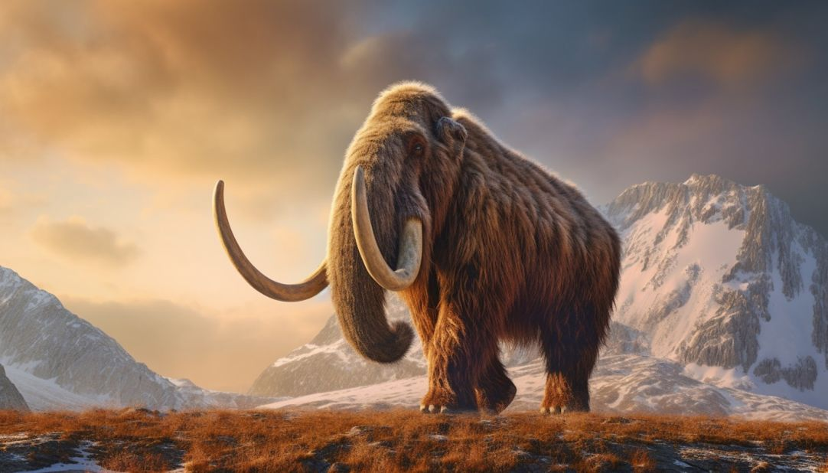
True Fossils
Complete organism without decomposition present trapped in ice or protective material like resions etc
Eg. 1. Wolly mammoth in siberia.
2. Resins contains pollen grains

Slide 6
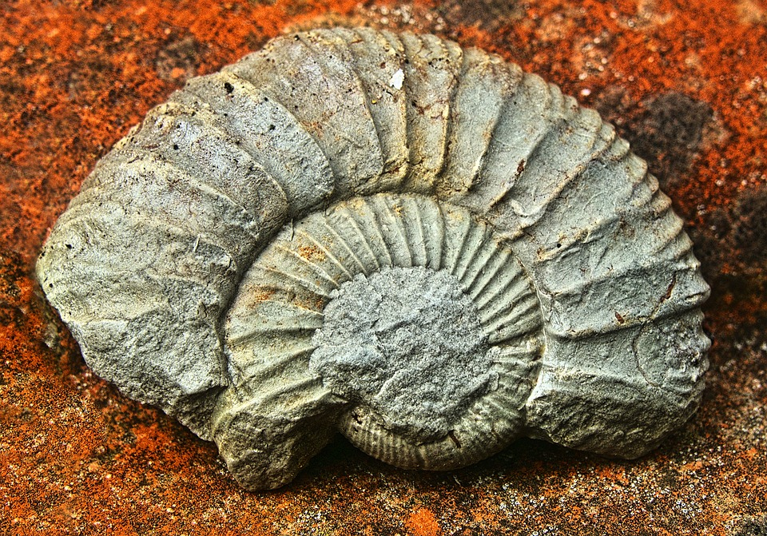
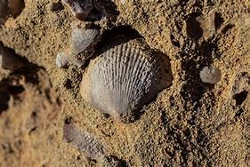
Petrified Fossils
In this type of fossils organic material is replaced by inorganic without changing morphology fossils.
Eg. Carbon replaced by silica.

Slide 7
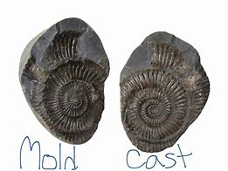
Mold fossils
These are imprints of organisms left in rock. As the organism’s remains break down completely, a cavity forms that preserves the exact imprint of the organism’s shape and size.
When this hollow space fills with material (such as sediment), it takes the shape of the mold. However, no organic material typically remains.
Imagine it like creating a mold for Jell-o and then filling it with the gelatin—the removed form is a cast of the mold

Slide 8
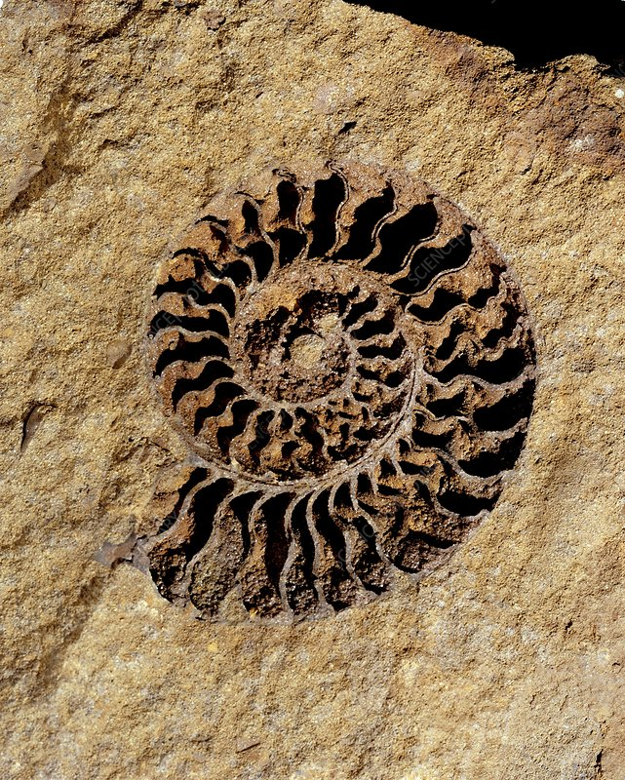
Cast fossils
These form when a mold fills with material (like sediments or soluble minerals) and creates a replica of the original organism.
Think of it as setting Jell-o in a mold and then removing it—the resulting form is the cast.
Casts provide paleontologists with clues about ancient organisms' surface anatomy and behavior.
For instance, insect wing impressions can be common fossil molds, revealing details that help identify insect families.

Slide 9
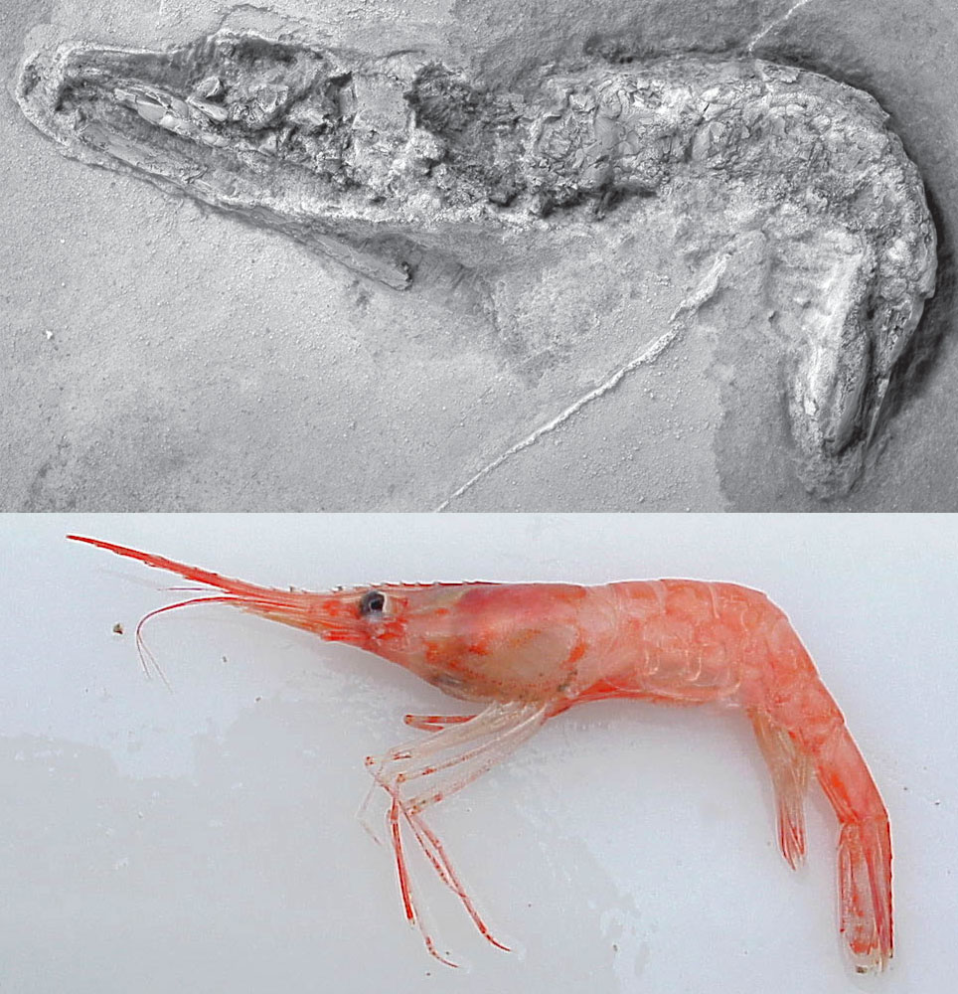
Living fossils
Living fossils are the living organisms having characters like the ancestors called as living fossils
E.g. Ginko tree, Crocodiles, Shrimps

Slide 10
Thank you

