Slide 1
Gene interaction
By,
Dr. Ravindra Pathre
HOD, Assistant Professor Zoology,
Mss College Ambad

Slide 2
Gene interaction
Definition- The phenomenon of two or more genes affecting the expression of each other in various ways in the development of a single character of an organism is known as gene interaction.
• Most of the characters of living organisms are controlled/ influenced/ governed by a collaboration of several genes.
• Mendel and other workers assumed that characters are governed by single genes but later it was discovered that many characters are governed by two or more genes.

Slide 3
• Such genes affect the development of concerned characters in various ways; this leads to the modification of the typical dihybrid ratio (9:3:3:1)
•In gene interaction, expression of one gene depends on expression (presence /absence) of another gene.

Slide 4
Types of Gene Interactions
• Gene interactions can be classified as
a) Allelic/ non epistatic gene interaction - This type of interaction gives the classical ratio i e. 3:1 or 9:3:3:1
b) Non-allelic/ epistatic gene interaction- In this type of gene interaction genes located on the same or different chromosome interact with each other for their expression
The discovery of non-allelic gene interaction was done after Mendel and can be best understood by studying phenotypic traits of gene

Slide 5
Epistatic and Hypostatic gene :
Epistatic gene :
When a gene or locus which suppress or mask the phenotypic expression of another gene at another locus such gene is know as epistatic gene.
Epistatic is Greek term and meaning is standing up
Hypostatic gene :
The gene or locus which was suppressed by a epistatic gene was called hypostatic gene.

Slide 6
Classification of epistatic gene interaction
• Epistatic gene interaction Gene is classified as follow on the basis manner by which concerned genes influence the expression of each other
1. Supplementary gene action / Recessive Epistasis (9:3:4)
2. Complementary gene action / (9:7)
3. Inhibitory gene action (13:3)
4. Duplicate gene interaction (15:1)
5. Masking gene action/ Dominant Epitasis (12:3:1)
6. Polymeric gene action (9:6:1

Slide 7
Supplementary gene action (9:3:4)
• In supplementary gene interaction, the dominant allele of one of two gene governing a character produces phenotypic effect
• However dominant allele of the other gene does not produce a phenotypic effect on its own
• But when it is present with dominant allele of the first gene it modifies the phenotypic effect produced by that gene.
• For example development of agouty (gray) coat color in mice.

Slide 8
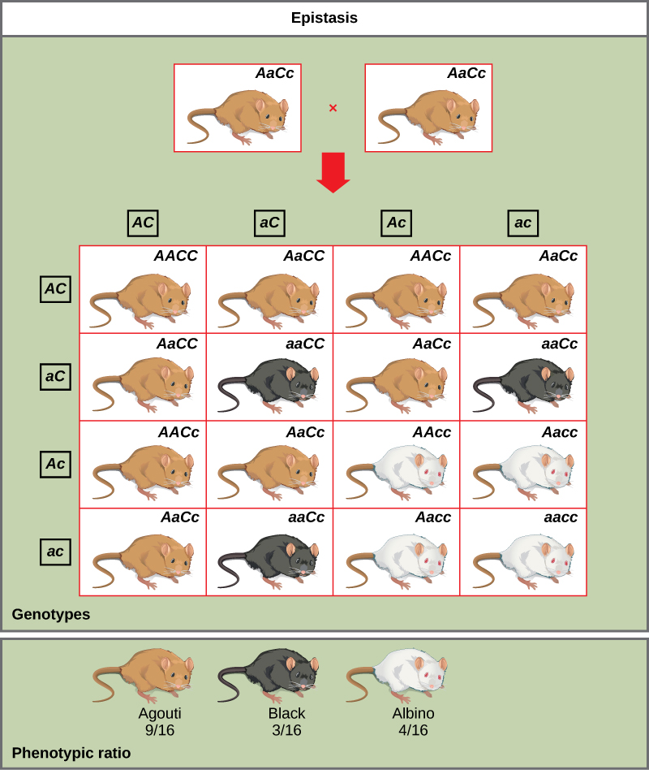
Dominant allele- C produces a Coloured phenotype while dominant allele A produces no phenotype (albino) but when dominant allele A present with C it produces agouti (grey) phenotype

Slide 9
2. Complementary gene interaction :
• If both gene loci have homozygous alleles and both of them produce identical phenotypes the F2 ratio become 9:7 instead 9:3:3:1
• In such case, the genotype aaBB, aaBb, Aabb, aabb produce one phenotype
• Both dominant alleles when present together each other are called complementary genes and produce a different phenotype

Slide 10
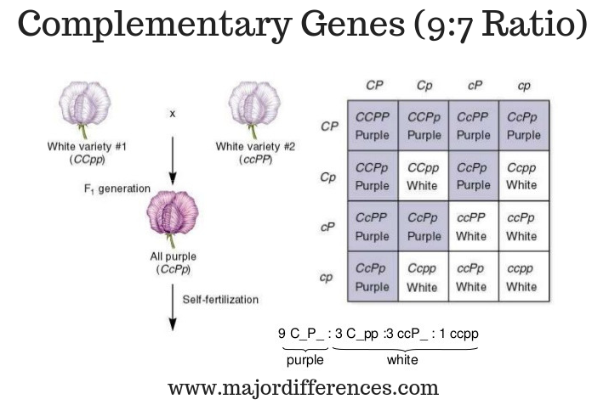
In sweet pea Presence of genes CC, cc, PP and pp in homozygous condition produces no color (white) because expression of chromogen doesn’t occur in homozygous condition while expression of chromogen occurs when these two genes present in heterozygous condition

Slide 11
3. Inhibitory gene action
• When dominant allele of one gene locus (B) in homozygous (BB) and heterozygous (Bb) condition produce the same phenotype the F2 ratio becomes 13:3 instead of 9:3:3:1
• While homozygous recessive (bb) condition produces different phenotype.
• Homozygous recessive (bb) condition inhibits phenotypic expression of other genes so know as inhibitory gene action

Slide 12
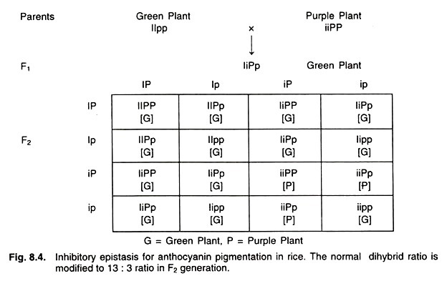

Slide 13
4. Duplicate gene interaction
• When dominant allele of both gene loci produce the same phenotype without cumulative effect
• In that case the ratio becomes 15:1 instead of 9:3:3:1
• Duplicate gene interaction occurs in shepherds purse plant.

Slide 15
5. Masking gene action (12:3:1)
• When out of two genes, the dominant allele (e.g., A) of one gene masked the activity of allele of another gene (e.g., B)
• Then A gene locus is said to be epistatic to the B gene locus
• Dominant allele A express itself only in the presence of either B or b so such type of epistatic is know as dominant epistatic
• The allele of hypostatic locus express only when the allele of epistatic locus present in homozygous recessive condition

Slide 16
References
www.Majordifferences.com.
https://www.slideserve.com/delphine/epistatic-gene-interactions
https://www.agriculturewale.com/wp-content/uploads/2021/09/Inhibitory-Epistasis.jpg
https://pressbooks.umn.edu/app/uploads/sites/46/2019/08/7-5-225x266.jpg

Slide 17
Thank you

