Slide 1
Mollusca
By:- Dr. Ravindra Pathre
HOD, Assistant Professor Zoology,
Arts, Science & Commerce College Ambad

Slide 2
Introduction of Mollusca
The term Mollusca was coined by Aristotle.
Mollusca were first defined by Cuvier
It is the second-largest phylum
Malacology is the study of molluscans.
Conchology is the study of cells.
Molluscans came into existence in the early Cambrian period.

Slide 3
General characters
1. Habitat: They are mostly marine. Many, however, occur in fresh water, and some even in damp soil.
2. Body Form: The body of a Mollusca is un-segmented with a distinct head, muscular foot and visceral hump. Neopilina is a segmented Mollusca.
3. Symmetry: They usually show bilateral symmetry. In some Mollusca like Pila, due to torsion (twisting) during growth, the adults become asymmetrical.
4. Shell: Shell is secreted by the mantle. It is made up of calcium carbonate. Shell may be external (e.g., most of Mollusca), internal (e.g., slug, cuttlefish, squid), or absent (e.g., Octopus).

Slide 4
5. Mantle (Pallium): It is a thin, fleshy fold of dorsal body wall more or less covering the body. It encloses a space, which is called the mantle cavity (= pallial cavity).
6. Body wall: Single layered epidermis is usually ciliated. Muscles are un-striped and occur in bundles
7. Body cavity: Coelom is greatly reduced. It is restricted to the pericardial cavity (space around the fieart), and to small spaces within kidneys and gonads (testes and ovaries). Spaces amongst the viscera (soft organs) contain blood and form haemocoel.
8. Digestive tract: It is complete.
9. Blood vascular system: It is open type. It includes dorsal heart, arteries that open into sinuses; (spaces) and veins.

Slide 5
10. Respiratory organs: These are gills (cteoidia). Mantle and pulmonary sae (in semiterrestrial form).
11. Excretory organs: Excretory organs are one or two pairs of sac- like kidneys. Gills are also excretory in function. Ammonia is chief excretory matter.
12. Nervous System: The nervous system comprises paired cerebral, pleural, pedal and visceral ganglia joined by the nerve connectives and commissures. Connectives connect dissimilar ganglia; however, commissures connect similar ganglia
13. Sense Organs: In many molluscas, eyes are present over stalks called ommatophores. Statocysts (balancing organs) may be present. Osphradium is present in some molluscs for testing chemical and physical nature of water.

Slide 6
14. Sexes: The sexes are generally separate but some are hermaphrodite.
15. Development: They are oviparous. The development is either direct or indirect (metamorphosis). When the development is indirect it includes a characteristic larva, liger, trochophore or glochidium. Asexual reproduction is absent.
Unique Features:
(i) Mantle covers the body,
(ii) Mantle may be surrounded by shell,
(iii) Nervous system consists of cerebral, visceral, pleural and pedal ganglia.

Slide 7
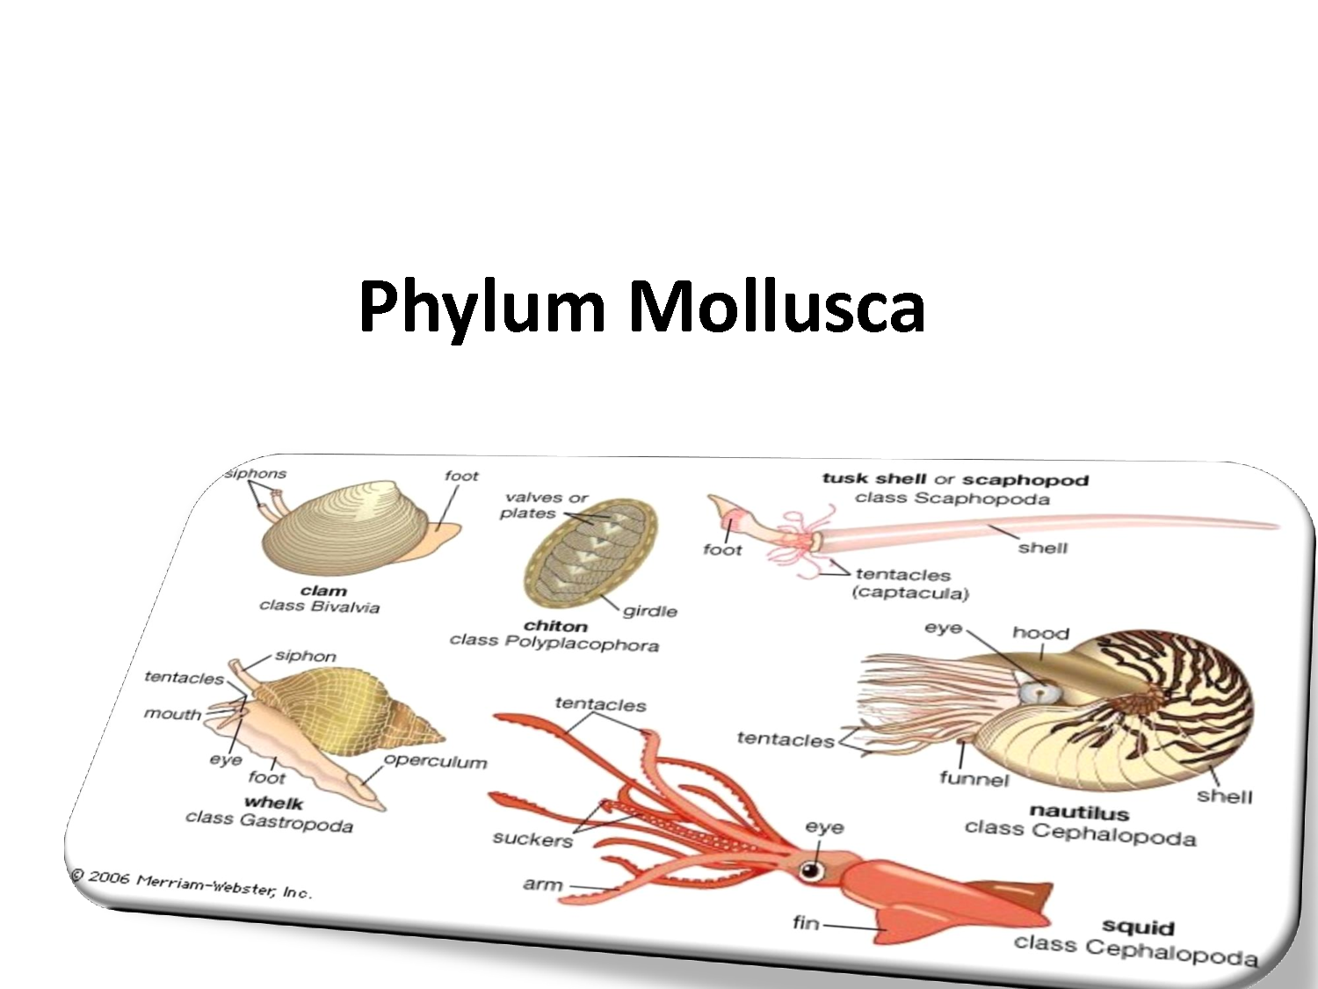

Slide 8
Pila –external characters
They are molluscs and thus have a soft and unsegmented body. Their body can be regionated into the head, visceral mass and foot.
The head has two pairs of tentacles, one pair of eyes, a ventral slit-like mouth or aperture and nuchal lobes.
Apple snails are found in various colours. They are typically globose in shape and are brown or lemon-yellow in colour.
In the shell, the outer margin of the aperture is called an outer lip, and the inner margin is called the columellar or inner lip.
The foot is a broad, flat, ventral and roughly triangular structure attached to the operculum.

Slide 9
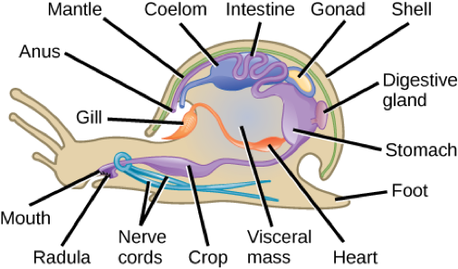
External Characters of Pila

Slide 10
Visceral mass is a hump-like structure containing the main organs. It fills the whorls of the shell and is also spirally coiled.
The mantle covers the visceral mass. It forms a hood over the snail when it is withdrawn. The mantle has a pigmented chemosensory patch called the osphradium that typically tests the quality of water.
Radula is present in the buccal mass.
The animal is well-protected by a spirally twisted shell. Only the foot and head come out of the shell mouth. The visceral mass lies inside the whorls of the shell.
The shell is coiled spiraltly o form the apex, body whorl and the penultimate whorl. Suture lines are present between the whorls. The shell shows right-hand or dextral coiling.

Slide 11
the shell surface shows lines of growth called the varices.
The unique feature of Pila is the presence of an operculum. Operculum is a calcareous anatomical structure which also has concentric lines of growth.
When the snail is inside the shell, it is covered by this structure called an operculum.
Pila respires with the help of the pulmonary sac and ctenidium (gills).
It has a heart with the pericardium, and renal organs are also present.
Sexes are separate, and fertilization is internal.

Slide 12
References
https://sp-uploads.s3.amazonaws.com/uploads/services/3420202/20220324080503_623c262f0602c_phylum_molluscapage1.png
https://d3rw207pwvlq3a.cloudfront.net/attachments/000/125/379/original/image.png?1597177668

Slide 13
Thank You

